Slide 1


Major Project
Title:
FinEase: Simplifying Financial Decisions using optimized ML and NLP Techniques
Presented by:
R2142210133 : Anusha Tripathi
R2142210584 : Pratyaksh Kumar Singh
R2142210421 : Khushi Srivastava
R2142210880 : Yutika Mishra
Mentored By:
Dr. Anand Kumar
Cluster Head :
Dr. Anil Kumar

Slide 2
CONTENT
Abstract
Introduction
Literature Review
Problem Statement
Objective
Methodology

Slide 3
ABSTRACT
In the ever-evolving world of personal finance, finding the right banking solutions tailored to individual needs can be overwhelming.
Our intelligent banking platform simplifies this process by integrating multiple financial services into a user-friendly website, empowering users to manage their finances with ease and confidence.
Our platform uses advanced data analytics and machine learning to provide personalized banking recommendations, loan eligibility predictions, and investment options based on user data like salary, credit score, and financial goals.
The seamless onboarding process collects income and financial preferences, recommending suitable banks for users without accounts by analyzing salary, interest rates, and balance requirements.

Slide 4
INTRODUCTION
The changing landscape of personal finance can make managing financial activities complex and overwhelming.
To address this challenge, we introduce an intelligent banking platform designed to simplify and enhance your financial management experience.
Our advanced algorithms analyze user data and utilize a comprehensive database of financial services to deliver personalized banking recommendations.
The platform ensures a tailored experience by considering individual factors such as salary, credit score, and financial goals.
Financial management is a personal journey, so the platform is designed to be both adaptable and efficient.
This intelligent banking solution is more than a tool; it’s a partner in your financial journey.

Slide 5
LITERATURE REVIEW
[1], Sumit Das (2015) highlights the dynamic landscape of AI, with machine learning emerging as a key technology. The paper proposes using SHAP to improve XGBoost interpretability for loan prediction.
[2], Donepudi (2017) discusses how AI and ML are transforming the banking sector, offering smarter, safer ways for customers to manage finances, urging banks to adapt to the tech-savvy customer base.
[3], Von Schomberg's definition of Responsible Innovation emphasizes the ethical acceptability, sustainability, and societal desirability of innovations, addressing global challenges like inequality and climate change.
[4], Hyun Woo Jeon (2020) explores customer retention in telecom, emphasizing the need to understand customer switching behavior to minimize churn and boost revenue.
[5], Ibrahim Ahmed Al-Baltah compares machine learning algorithms for predicting customer churn in banking, finding that Enhanced Random Forest Algorithm (ERFA) outperforms the default RF model in both balanced and imbalanced scenarios.
[6], Israa M. Hayder examines online banking using logistic regression and SVM models, concluding that SVM outperformed logistic regression in predicting commercial financial transactions.

Slide 6
PROBLEM STATEMENT
In the complex world of personal finance, individuals encounter numerous challenges while trying to effectively manage their financial activities. The current financial landscape faces several key issues such as:
Overwhelming Choices: With a wide range of banking services, loans, and investment products available, users often struggle to navigate options and select solutions that align with their specific needs.
Difficulty in Understanding Financial Products: Financial terms, interest rates, and eligibility criteria can be confusing, preventing users from making well-informed decisions about loans and investment opportunities.
Constantly Evolving Financial Sector: The financial industry is continuously changing, with new products, services, and regulations emerging, making it hard for users to stay updated and choose the best options.
Our intelligent banking platform aims to address these challenges by offering a personalized, user-centric, and informative experience, empowering individuals to confidently manage their financial journey with ease.

Slide 7
OBJECTIVE
User Data Analysis: Provide personalized bank recommendations through keyword-based or text-based search filtering algorithms.
Sentiment Analysis: Enhance personalized bank recommendations using Natural Language Processing (NLP) for sentiment analysis.
Financial Marketing Trend Analysis: Utilize machine learning to analyze and record financial marketing trends in real-time.

Slide 8
METHODOLOGY
Data Collection:
User Data: Collect financial profiles (salary, age, banking preferences).
Bank Data: Gather info on interest rates, fees, and product features.
Feature Engineering: Analyze and transform raw data into usable features for model preparation.
Model Selection: Using Key-word based search filtering algorithm to recommend suitable loans and accounts to users according to their preferences.
Sentiment Analysis: Apply NLP tools to classify customer reviews as positive or negative.
User Interface: Build an interface to calculate monthly interest based on principal, rate of interest, and duration.

Slide 9
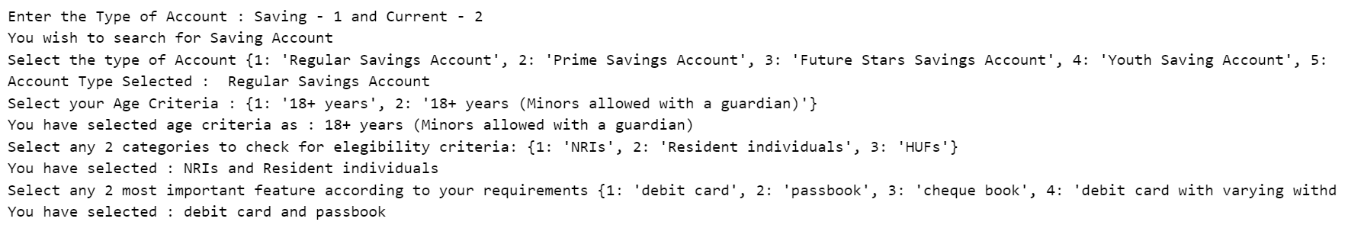
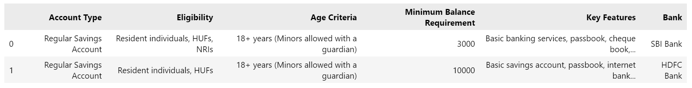
PROJECT PROGRESS
Recommendation of Bank Accounts
Input –
Output –

Slide 10
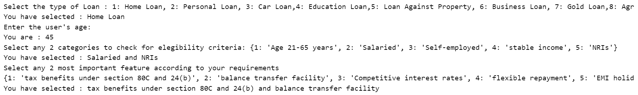
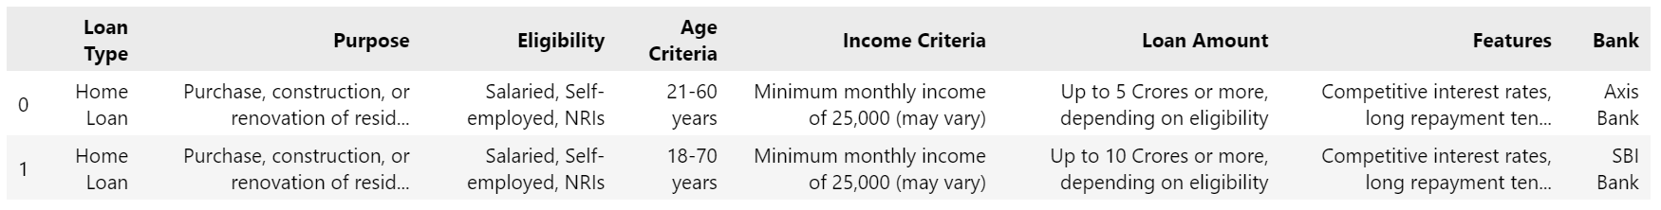
PROJECT PROGRESS
Recommendation of Loan Accounts
Input –
Output –

Slide 11

PROJECT PROGRESS
Sentiment Analysis
Input –
Output –

Slide 12
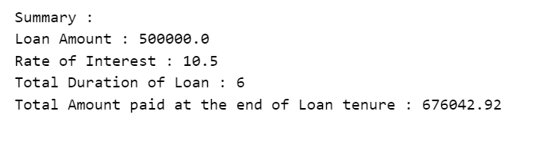
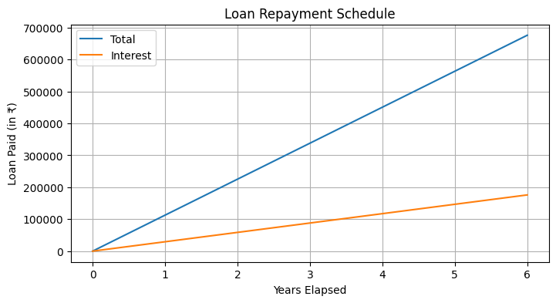
PROJECT PROGRESS
EMI Calculator
Input –
Output –

Slide 13
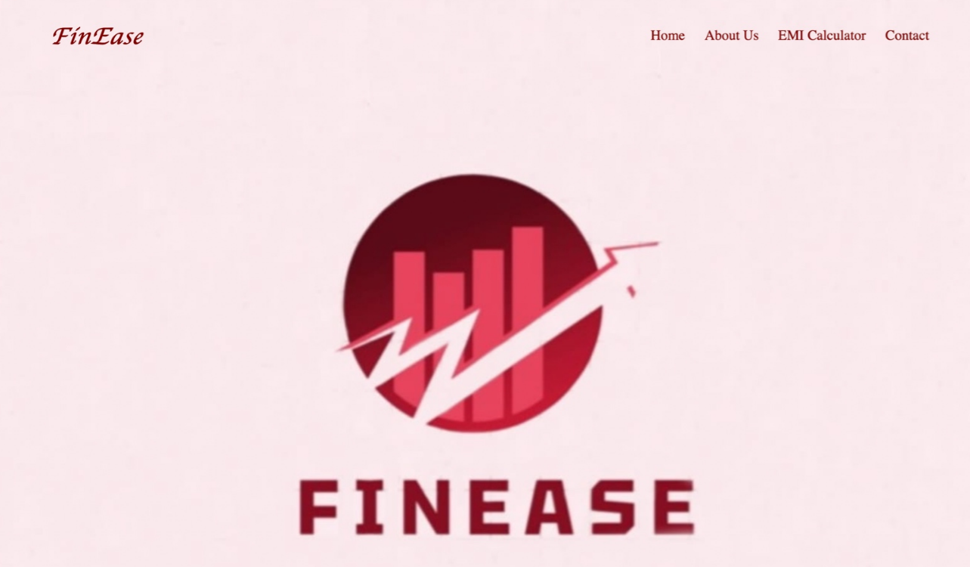
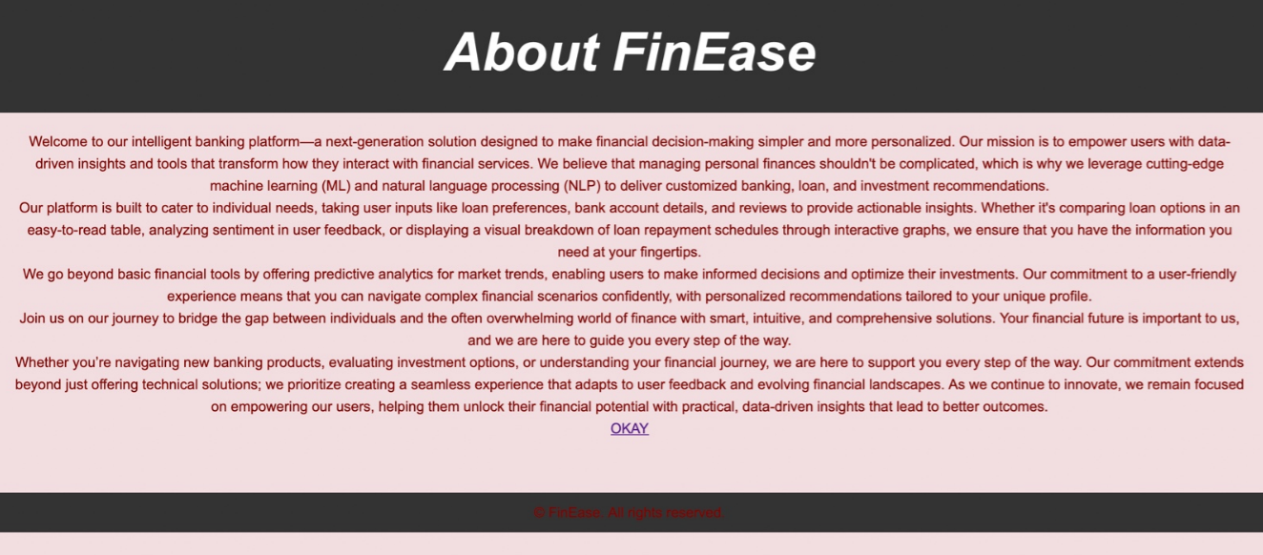
PROJECT PROGRESS
Front-end:

Slide 14
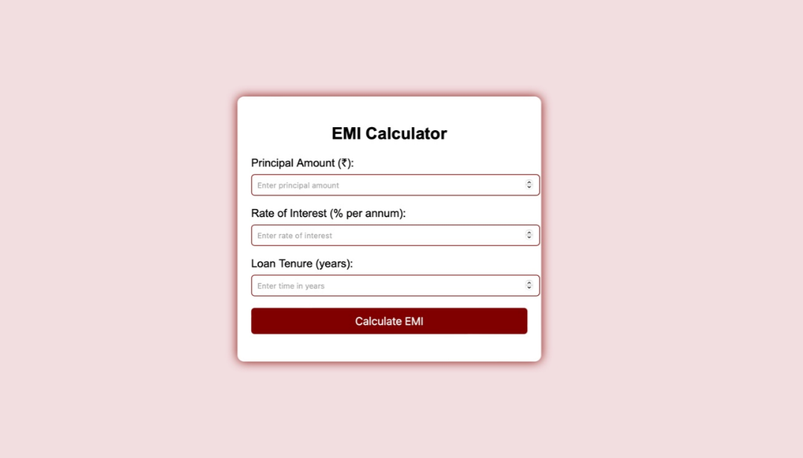
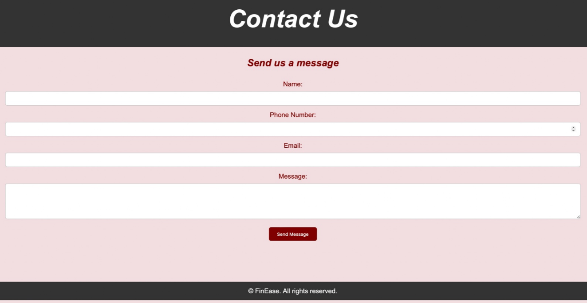
PROJECT PROGRESS

Slide 15
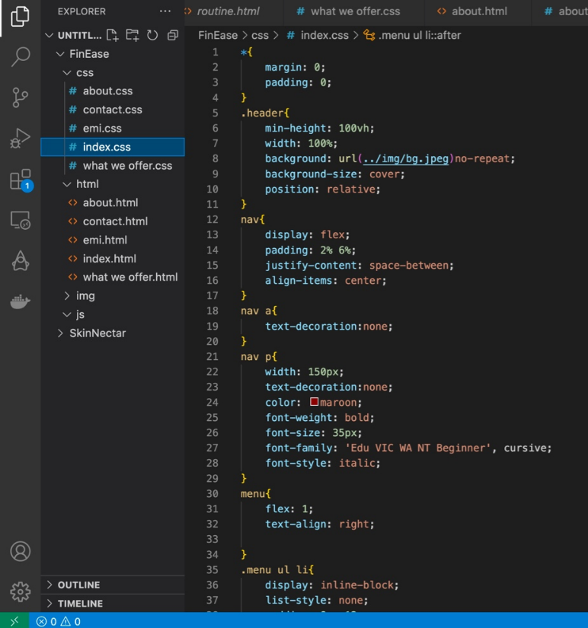
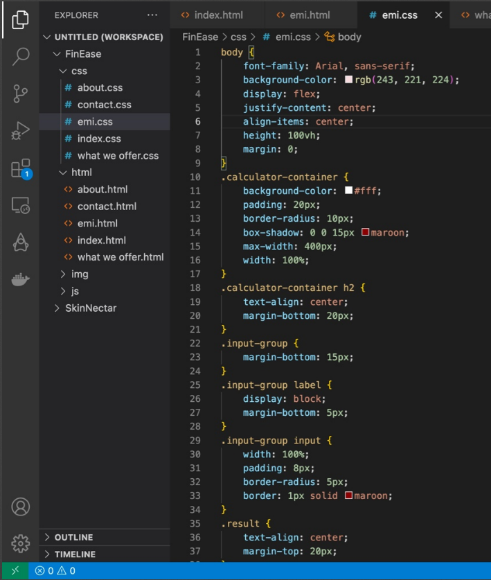
PROJECT PROGRESS
Code:

Slide 16
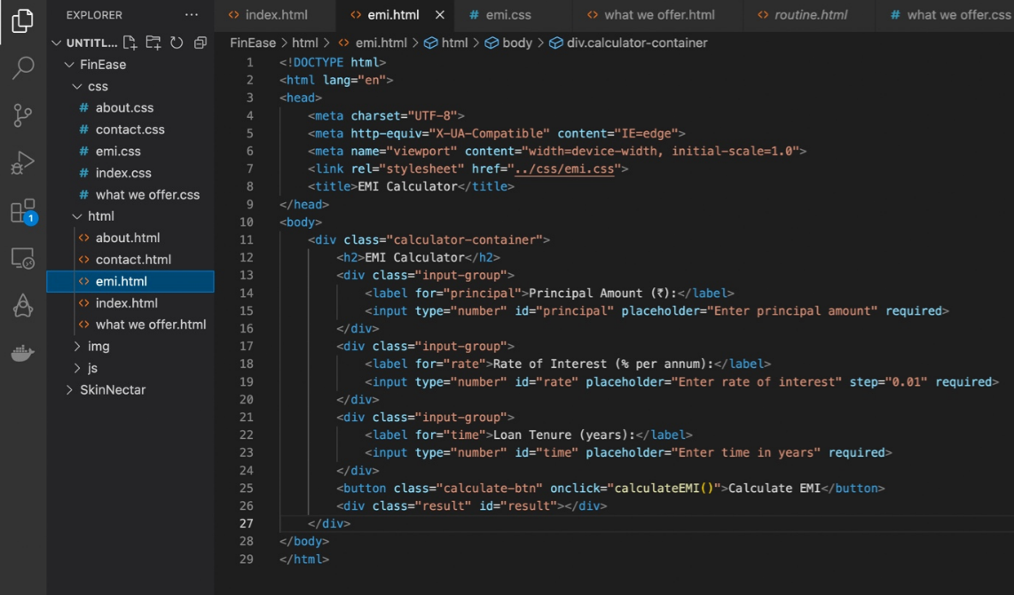
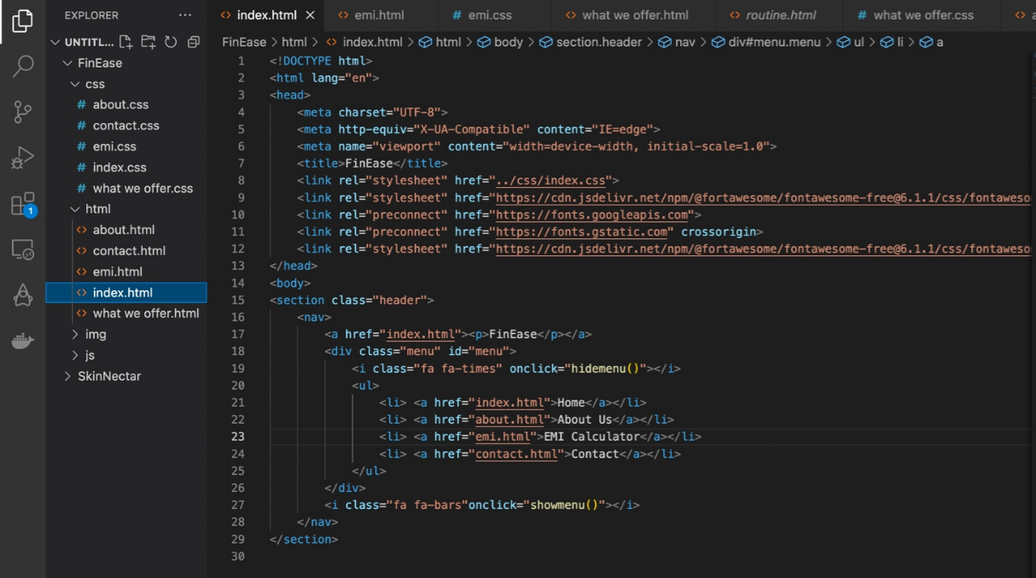
PROJECT PROGRESS

Slide 17
Thank You

